Slide 1
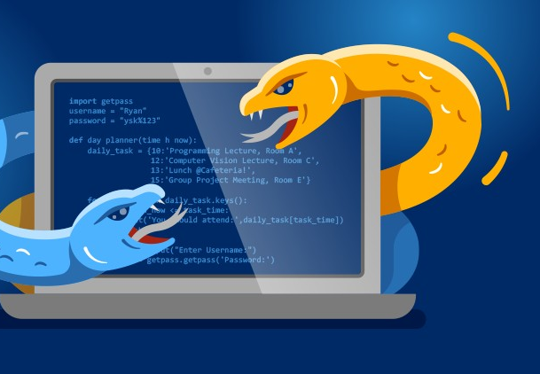

Python Adv (Geavenceerd)
By Yilmaz Mustafa

Slide 2
Working with Images

Slide 3
In this section we will focus on learning how to work with images with the Pillow library, we’ll install it with pip install pillow and then show you how to open and save image files and interact with images.
Let’s get started!

Slide 4
Overview of
Working with Images

Slide 5
In this lecture we will explore how to work with Images with Python.
We will use the Pillow library for this, which is a fork of the PIL (Python Imaging Library) with easy to use function calls.
We will need to install this additional library.

Slide 6
Install it at your command line with:
pip install pillow
You can find the official documentation for it at:
pillow.readthedocs.io

Slide 7
Image Exercise
Overview

Slide 8
Image Exercise
Solution

Slide 9
